Slide 1

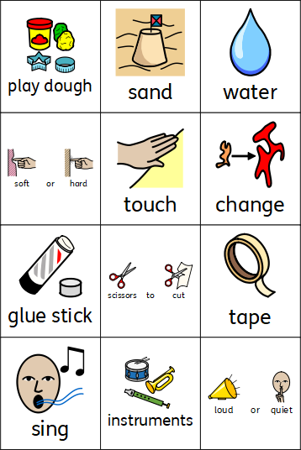
Expressive Arts and Design
Coleman Primary School, Nursery, Autumn 1
Theme – Why am I a Superhero? (What can I already do and what new Superhero skills and knowledge will I learn?)
Area of Learning - Expressive Arts and Design (Art, Design Technology, Music)
In Nursery your child will learn the skills to:
Explore different materials – sand, water & play dough
Develop ideas about how to use different materials and what to make.
Explore different building blocks and how to create their own ideas.
Sing familiar songs.
To produce different sounds when using instruments.
Respond to music with different movements and tapping out a simple pulse
Use resources to act out familiar stories or events from own experiences.
In Nursery your child will learn:
The children will know where they can go in the room if they want to: paint, draw, cut, stick, build a model, sing a rhyme and play an instrument.
Materials look and feel different. To use different words to describe how they feel/look.
How they can use glue, scissors and tape in their learning.
Instruments make different sounds. The sounds can be changed e.g. quiet/loud.
Different materials can be used in different ways.
How to use different resources in their role play.
Building blocks can be balanced & joined in different ways.
Different music and songs have a pulse and make us move in different ways

