Slide 1

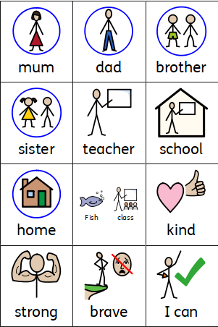
Understanding the World
Coleman Primary School, Nursery, Autumn 1
Theme – Why am I a Superhero? (What can I already do and what new Superhero skills and knowledge will I learn?)
Area of Learning- Understanding the World (Science, History, Geography, RE).
In Nursery your child will learn the skills to:
To explore the nursery – to find the different learning areas.
To use the resources in the different areas purposefully in their learning.
To use their different senses to explore different materials.
To talk about what they have learnt to do.
To recognise similarities/ differences between theirs and other families.
Identify what they can do and have learnt to do naming their Superpowers.
To respond to their class name.
To use the adults and friends’ names.
In Nursery your child will learn:
We are called Coleman Primary school.
There are different areas in the nursery – the home area, the writing area, the creative area.
Adults are here to help them.
The classes have names.
The names of the adults and friends in their class.
Where to find the resources they need.
The name of the different resources they use.
That families can be different from our own.

