Slide 1

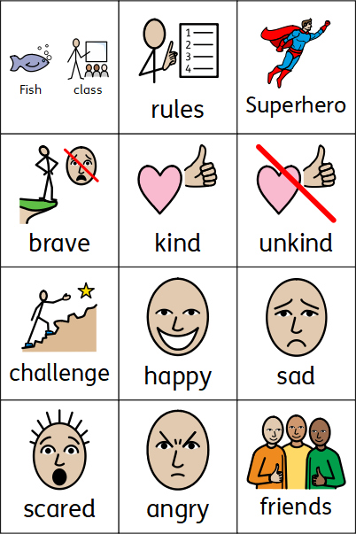
Personal, social and emotional development
Knowledge organiser, Coleman Primary School, Nursery, Autumn 1
Theme: “Why am I a superhero?”
Area of learning – Personal, Social, Emotional Development (Cambridgeshire Personal Development Program Foundation Framework)
In Nursery your child will learn:
We go to Coleman Primary School.
We are the Fish Class.
I am in the red/blue/ green fish family.
We have rules that we all should follow.
We all can feel different emotions during the day.
How to express these different emotions in the right way.
To recognise what makes us superheroes: what we can already do and what we can learn to do
Being kind, brave and to keep trying makes us a superhero.
We all have similarities and differences.
Our home environment and families can be similar and different too.
In Nursery your child will learn the skills to:​
Understand meaning and importance of belonging in the class.
Identify the similarities and differences between people including families.
Setting their own challenges
Understand the importance of rules and responsibilities.
Identify and manage emotions.
Valuing difference and diversity.

