Slide 1

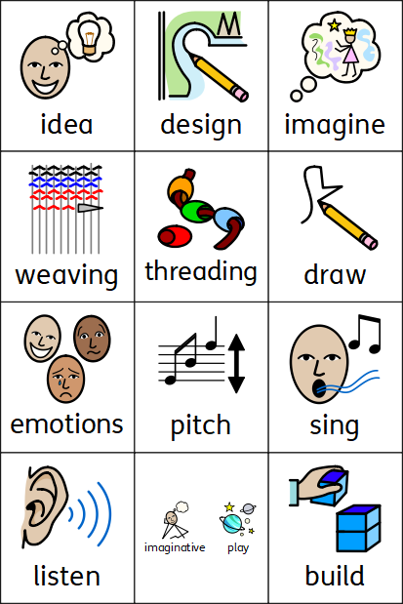
Expressive Arts and Design
Coleman Primary School, Nursery, Spring 2
Theme – What’s beyond the clouds?
Area of Learning - Expressive Arts and Design (Art, Design Technology, Music)
I can change the pitch of my voice.
I can make a design of what I would like to make.
I can weave different materials.
In Nursery your child will learn:
To create their own story lines while engaging in small world play about space.
To use loose parts and construction equipment in their imaginative play to create models related to space.
To use their voice to show different emotions through altering the pitch
To listen and talk about recordings of their own voice and changes in pitch.
To follow pictures to create music with different pitches.
To sing 2 pitches in tune
That a design is a way of planning our idea before we start.
To know that threading is putting one material through an object.
To weave different materials

