Slide 1

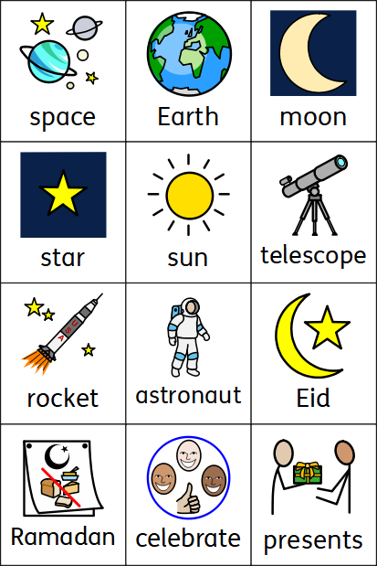
Understanding the World
Coleman Primary School, Nursery, Spring 2
Theme – What’s beyond the clouds?
Area of Learning- Understanding the World (Science, History, Geography, RE).
In Nursery your child will learn:
That we live on planet Earth.
Where space is and what is in space: stars, planets, space stations
That people travel to space in a rocket.
That people have travelled up to space in the past
That people discovered stars and planets in space using telescopes
To know people have been to the moon.
That looking at photos and videos show us how different space travel is now compared to the past
About/name key customs in the Eid celebration e.g. praying, family meal, presents etc..
We live on Earth.
Astronauts have landed on the moon.
At the end of Ramadan, Muslim people celebrate Eid.

