Slide 1

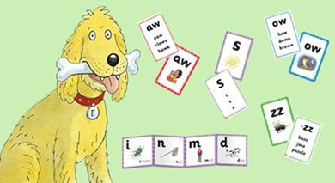
Phonics in Reception

Slide 2
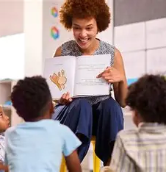
The Importance of Reading
Reading should be fun and exciting!
We love to share stories at Coleman, and we want your child to grow a love for books, just like we have.
We read two stories a day to our class and we use story language such as front cover, title, blurb, character.
Through teaching phonics, your child will learn the sounds they need to be able to read books by themselves.
They will also learn the helpful words to increase their sight vocabulary.

Slide 3
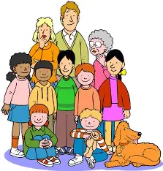
Our Phonics Scheme
All schools have to use a government approved synthetic phonics program.
Floppy Phonics is our school’s scheme and it uses the key characters of Chip, Biff, Kipper and Floppy the dog. These are found in many of the books your child will bring home.
Floppy Phonics is the way we teach your child early reading and writing.
Phonics is taught each day using fun, multisensory approaches.
Your child will receive follow up tasks both in the classroom and through their homework.

Slide 4
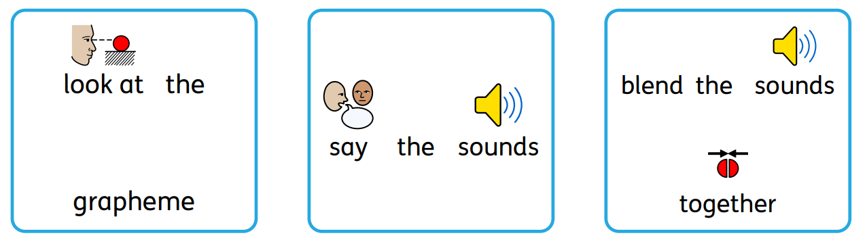
Our phonics lessons
We teach pure sounds as follows: Click this link
We look at the picture and develop vocabulary from it.
The child is taught the name of each letter and the sound made by each letter.
They are shown how to form the letter.
They are taught that the grapheme is how the sound looks when it is written down.
They learn how to read a word by saying the sounds:

Slide 5
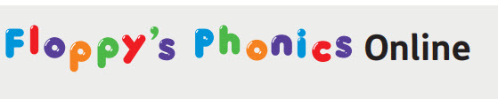

Your child will have access to Floppy’s Phonics Online which is a subscription service with interactive phonics lessons and activities to teach sounds, blending, grapheme-phoneme correspondence, letter formation and pronunciation.
This allows children to practise their learning at home. Oxford Owl for School and Home - use this programme to help your child practise and consolidate their reading skills at home.

Slide 6
Phonics terminology your child will use at school:
Phoneme | A phoneme is the smallest unit of sound in a word. There are 44 phonemes in the English language. | Oral blending | Hearing a series of spoken phonemes and merging them together to make a spoken word. e.g. teacher says “b-u-s” children say “bus”
Grapheme | Graphemes represent how a phoneme is spelt. Each grapheme is a unit of sound regardless of how many letters there are. | Blending (links to reading) | Recognising the letter sounds in a written word and merging them together in the order they are written to pronounce the word. e.g. c-u-p = cup
Diagraph | Two letters, which makes 1 phoneme. e.g. duck. Or ship. | Segmenting (links to writing) | Identifying the individual phonemes in a spoken word and writing them down to form a word.
Trigraph | Three letters, which make 1 phoneme. e.g. light

Slide 7
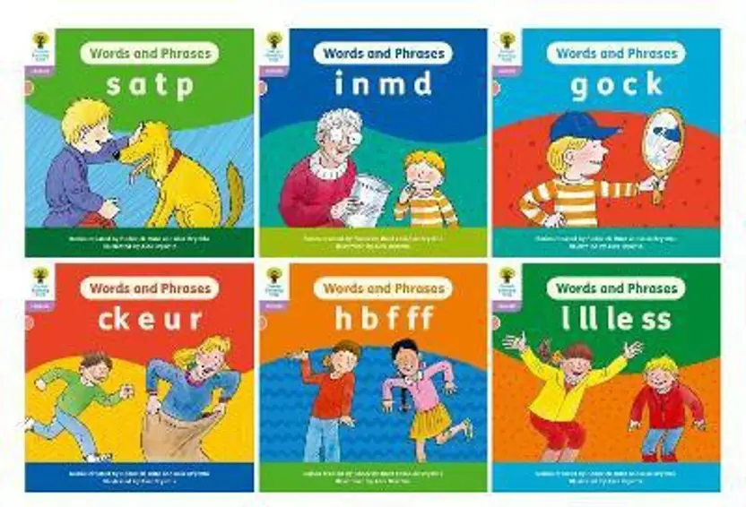
Reading books for home
Your child will bring a reading book home from next Friday, September 26^{th.} The reading book will be matched to your child’s ability by the teacher. It will be changed each Friday.
They will need a book bag. Please bring this each day with the reading record inside too.
It is best to hear your child read as often as possible. Encourage them to look at the graphemes, say the sounds and blend the sounds together. You can help them with this if they find it tricky at first.
Any successes or problems can be recorded in the reading record.
Practise the helpful words whenever you hear your child read. This will help them to gain fluency when reading and writing.

Slide 8
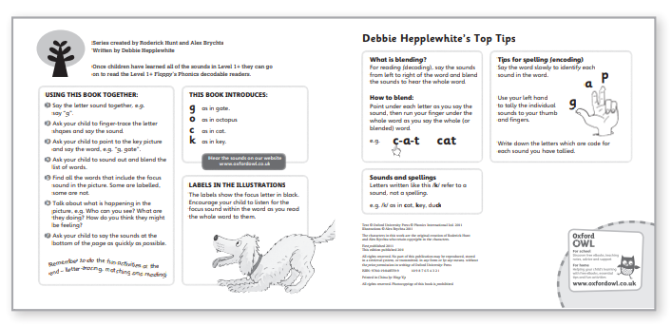
Some of the phonic decodable books' children bring home will have helpful advice and guidance for you to use with your child at home.

Slide 9
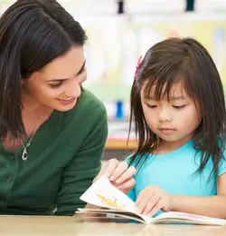
Supporting your child at home
Hear them read their book each day, if possible, and write in their reading record. Choose a quiet time and place for this and use lots of praise!
Visit the Oxford Owl page for the sounds we have covered that week
Practise letter formation as shown on the homework and online too
Help your child to learn the helpful words off by heart
Read story books to them at home and talk about the illustrations, the characters and what they liked about the book

