Slide 1


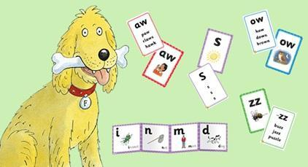
Parents’ Guide to Phonics
At
Coleman Primary School

Slide 2

Phonics
at
Coleman Primary School
Phonics is proven to be the most effective method of teaching children to learn to read as it simplifies the English language down into just 44 sounds. Children therefore 'decode' words by breaking them down into its sounds rather than having to memorise thousands of words individually.
Click this link to hear how pure sounds are pronounced correctly.

Slide 3
At our school, we teach early reading and writing to our children using a rigorous systematic synthetic phonics programme called Floppy’s Phonics. Floppy's Phonics is a beautifully crafted programme that is rigorous, easy-to-use and engages children from the outset, enabling them to learn to read quickly. This wonderful programme teaches the letter/sound correspondences of the English alphabetic code explicitly and comprehensively for reading and spelling. It includes the characters of Floppy the dog, Biff, Chip and Kipper, which engages children fully for the phonics teaching & learning, vocabulary enrichment and language comprehension.
Alongside our programme, we use high quality resources for effective and consistent phonics teaching. Our children engage in fun, multisensory phonics lessons 5 days a week, for 30mins through EYFS to KS1.
Click this link to see how we teach phonics and what resources we use as part of our Floppy's Phonics programme.

Slide 4
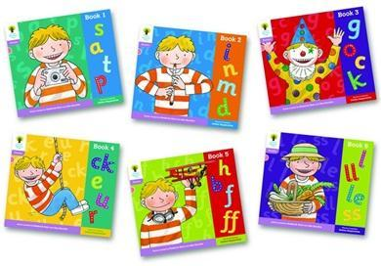
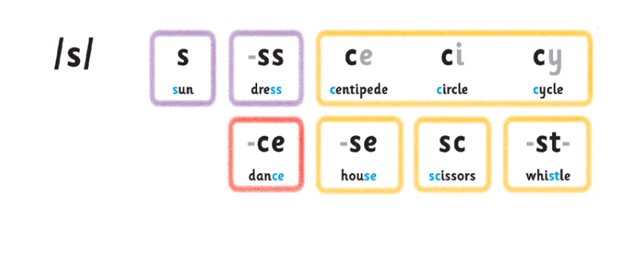
To reinforce the phonics teaching in school, your child may bring home some books and activities to share with you. This includes:
Fully decodable phonics book linked to the sounds/phase they are learning in school.
Floppy Phonics Activity sheet
Say the sounds poster
Grapheme and picture tiles
Mini Alphabetic Code – This is a very helpful teaching and learning tool; It clarifies understanding of the relationship between the sounds of our speech and the written codes or the letters and letters groups allotted to those sounds, e.g.
The next page has a copy of the Mini Alphabetic code the children will be using in school and at home.

Slide 5
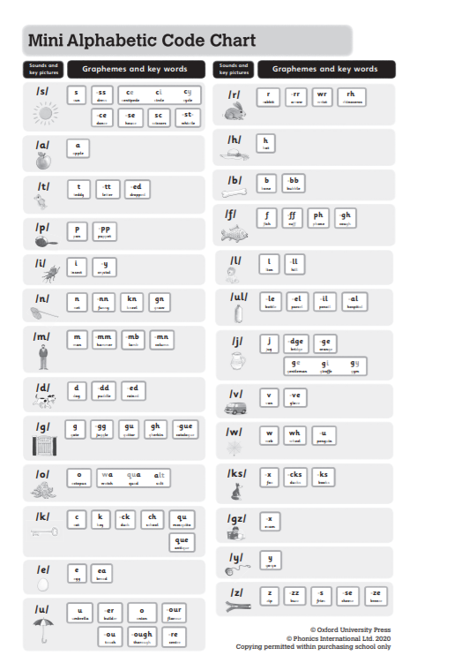
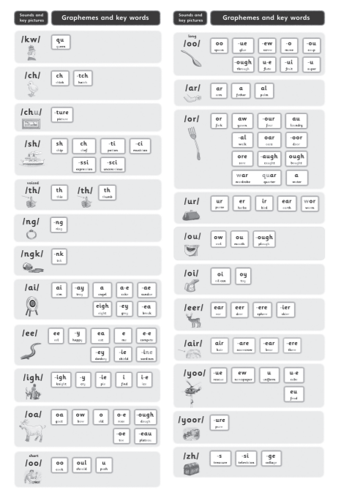

Slide 6
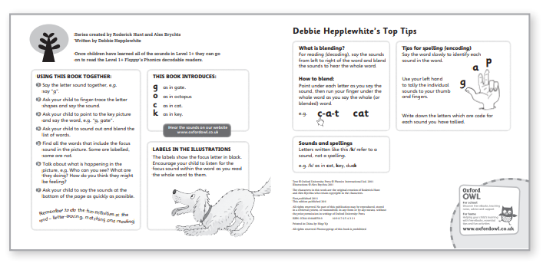
All the phonic decodable books children bring home will have helpful advice and guidance for you to use with your child at home.

Slide 7
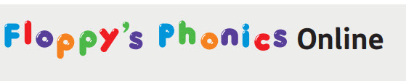

Your child will also have access to Floppy’s Phonics Online; Floppy's Phonics Online is a subscription service with interactive phonics lessons and integrated activities to teach sounds, blending, grapheme-phoneme correspondence, letter formation and pronunciation. This programme allows children to practise their learning at home. Please Click Here to find out how you can use this programme to help your child practise and consolidate their reading skills at home.

Slide 8
Phonics terminology your child will use at school.
Phoneme | A phoneme is the smallest unit of sound in a word. Feel/watch how your mouth changes when you say a word, every time your mouth moves/changes shape you are saying a new phoneme, e.g. b-r-i-ck There are 44 phonemes in the English language | Trigraph | Three letters, which make 1 phoneme. e.g. light
Grapheme | Graphemes represent how a phoneme is spelt. Each grapheme is a unit of sound regardless of how many letters there are. e.g. The word b-r-igh-t is made up of 4 phonemes; the igh phoneme is represented by 3 letters but only makes one phoneme. A grapheme can represent more than one phoneme e.g. C = cat and city | Oral blending | Hearing a series of spoken phonemes and merging them together to make a spoken word without corresponding to any graphemes e.g. teacher says “b-u-s” children say “bus”
Diagraph | Two letters, which makes 1 phoneme. e.g. duck A consonant diagraph contains 2 consonants e.g. sh ck th ll A vowel diagraph contains at least one vowel e.g. ai ee ar oy | Blending (links to reading) | Recognising the letter sounds in a written word and merging them together in the order they are written to pronounce the word. e.g. c-u-p = cup
Split Diagraph | A diagraph in which the two letters are not adjacent e.g. make - a-e is a unit of sound (diagraph)- it is being ‘split’ by the constant k. | Segmenting (links to writing) | Identifying the individual phonemes in a spoken word and writing them down to form a word.

Slide 9

Phonics Screening Check
In Year 1, children will sit a national Phonics Screening where the children have to read 20 real words and 20 ‘alien’ (pseudo) words. This is conducted in a very child-friendly way by the class teachers. At every parents evening you will be informed of your child’s progress in Phonics and at the end of Year 1 the school report will inform you if they have passed or not. If your child does not pass in Year 1 they will be given additional support throughout Year 2 to enable them to pass next year. We hold a parents workshop on the Phonics Screening check during spring term where you will gain further information on this.
Click on links provided below to access past Phonics screening check papers.
Phonics screening check: 2019
Phonics screening check: 2018
Phonics screening check: 2017

