Slide 1
All is found

Slide 2
Where the north wind meets the sea
There's a river full of memory
Sleep, my darling, safe and sound
For in this river all is found
In her waters, deep and true
Lay the answers and a path for you
Dive down deep into her sound
But not too far or you'll be drowned

Slide 3
Yes, she will sing to those who'll hear
And in her song, all magic flows
But can you brave what you most fear?
Can you face what the river knows?
Where the north wind meets the sea
There's a mother full of memory
Come, my darling, homeward bound
When all is lost, then all is found
Is found
All is found

Slide 4
Beyond the Sea

Slide 5
Beyond the Sea
Somewhere beyond the sea
Somewhere waiting for me
My love still stands on golden sands
And watches the ships that go sailin'
Part 1 Somewhere
Part 2 Somewhere
beyond the sea
She's there watching for me
If I could fly like birds on high
Then straight to her arms
I'd go sailing

Slide 6
Part 2 It's far
Part 1 Yes it’s far
beyond the stars
It's near beyond the moon
I know beyond a doubt
My heart will lead me there soon
Part 2 Will lead me there soon
Part 1 We'll meet
Part 2 We’ll meet

Slide 7
beyond the shore
We'll kiss just as before
Happy we'll be beyond the sea
And never again I'll go sailing
No more sailing
No more sailing
No more sailing
No more sailing
Yeah

Slide 8
Let the River Run

Slide 9
Let the river run
Let all the dreamers wake the nation
Come the new Jerusalem
Silver cities rise
The morning lights
The streets that lead them
And sirens call them on with a song
It’s asking for the taking,
Trembling, shaking
Oh my heart is aching
We’re coming to the edge, running on the water
Coming through the fog
Your sons and daughters

Slide 10
We the great and small
Stand on a star
And blaze a trail of desire
through the darkning dawn
It’s asking for the taking,
Trembling, shaking
Oh my heart is aching
We’re coming to the edge, running on the water
Coming through the fog
Your sons and daughters
Let the river run
Let all the dreamers wake the nation
Come the new Jerusalem
Come the new Jerusalem

Slide 11
We the great and small
Stand on a star
And blaze a trail of desire
through the darkning dawn
It’s asking for the taking,
Trembling, shaking
Oh my heart is aching
We’re coming to the edge, running on the water
Coming through the fog
Your sons and daughters
Let the river run
Let all the dreamers wake the nation
Come the new Jerusalem
Come the new Jerusalem

Slide 12
Under the Sea

Slide 13
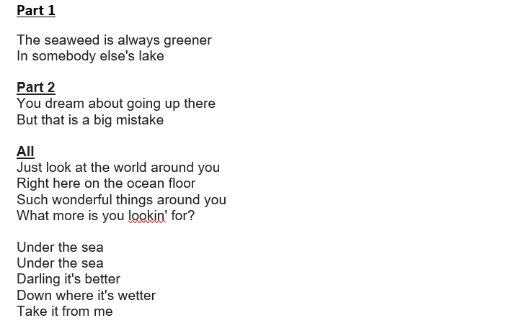

Slide 14
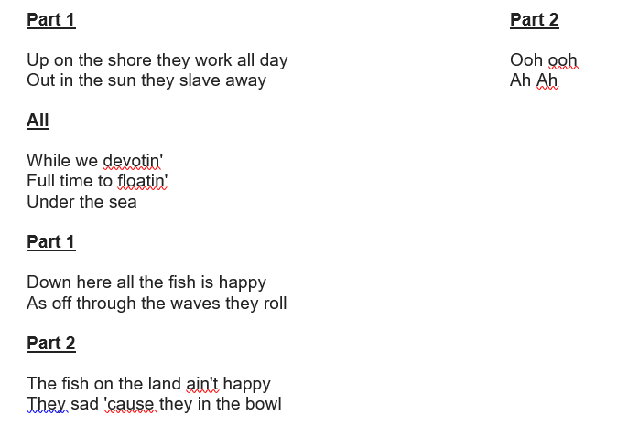

Slide 15
All
But fish in the bowl is lucky
They in for a worser fate
One day when the boss get hungry
Guess who's gon' be on the plate?
Under the sea
Under the sea
Nobody beat us
Fry us and eat us
In fricassee

Slide 17
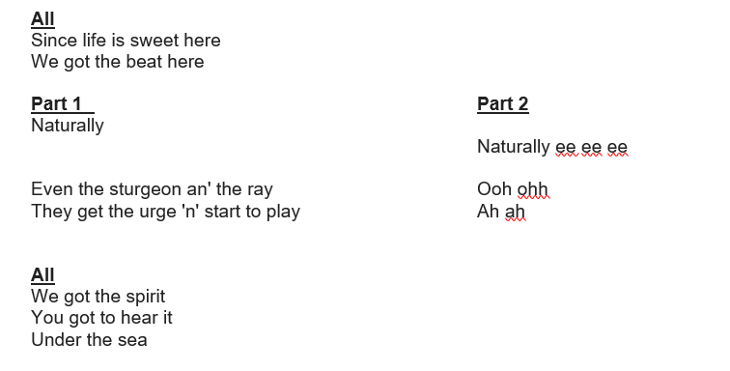

Slide 18
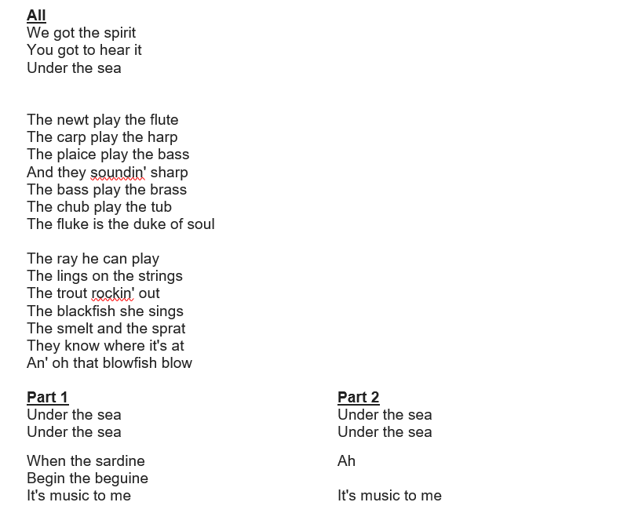

Slide 20
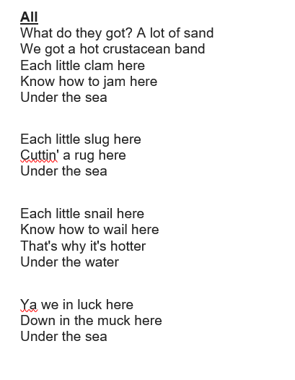

Slide 21
We know the way

Slide 22
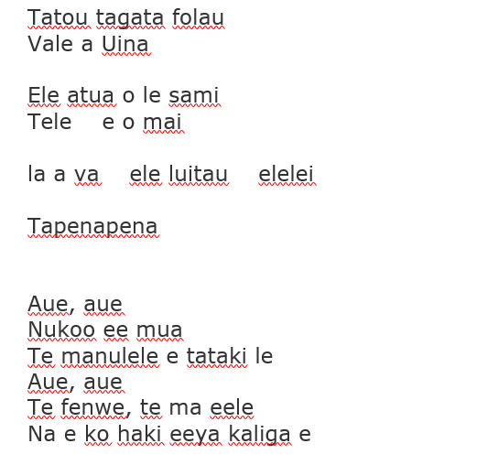

Slide 23
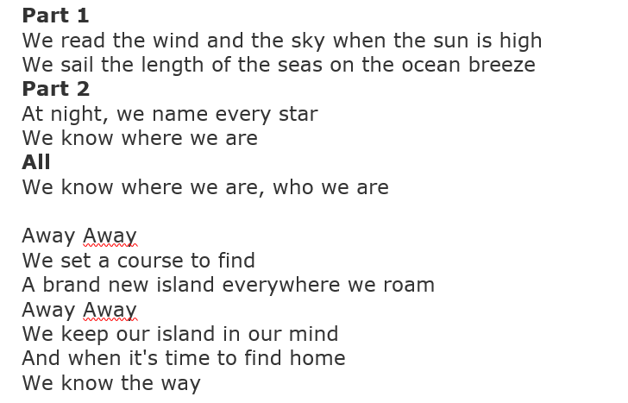

Slide 24
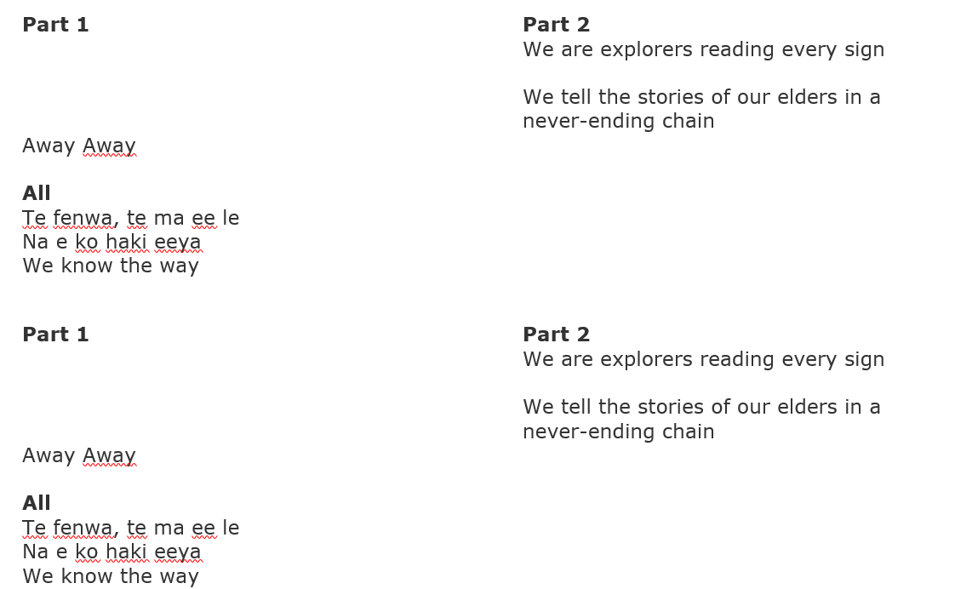

Slide 25
Walking on Sunshine

Slide 26
Oh!
Ohhhh, yeeeh
I used to think maybe you loved me now baby I'm sure
And I just can't wait till the day when you knock on my door
Now everytime I go for the mailbox, gotta hold myself down
'Cause I just can't wait till you write me you're coming around
I'm walking on sunshine, wooah
I'm walking on sunshine, woooah
I'm walking on sunshine, woooah
And don't it feel good!
Hey, alright now
And dont it feel good!
Hey yeah

Slide 27
I used to think maybe you loved me, now I know that it's true
And I don't want to spend my whole life, just waiting for you
Now I don't want u back for the weekend
Not back for a day, no no no
I said baby I just want you back and I want you to stay
Woah yeah!
I'm walking on sunshine, wooah
I'm walking on sunshine, woooah
I'm walking on sunshine, woooah
And don't it feel good!!
Hey, alright now
And don't it feel good!!
Yeah, oh yeah
And don't it feel good!!
Walking on sunshine
Walking on sunshine

Slide 28
I feel alive, I feel the love, I feel the love that's really real
I feel alive, I feel the love, I feel the love that's really real
I'm on sunshine baby oh, oh yeah
I'm on sunshine baby oh
I'm walking on sunshine, wooah
I'm walking on sunshine, wooah
I'm walking on sunshine, woooah
And don't it feel good
Hey, alright now
And don't it feel good
I'll say it, say it, say it again now
And don't it feel good!!
Ohhhh, yeahhhh
And don't it feel good
Now don't it, don't it, don't it, don't it, don't it, don't it feel good
I'll say it, say it, say it again now
And don't feel good
Now don't it, don't it, don't it, don't it, don't it, don't it feel good
Tell me, tell me, tell me again now
And don't it feel good

